Slide 1
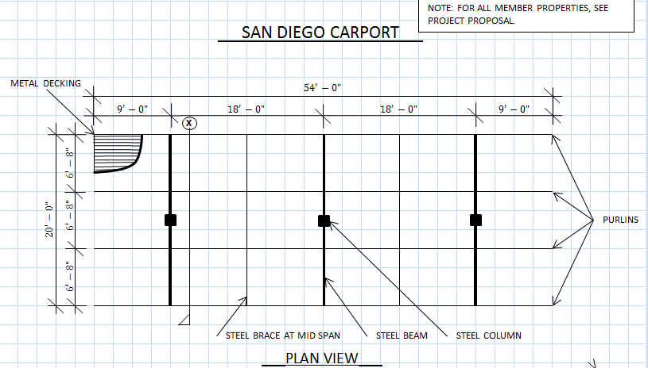
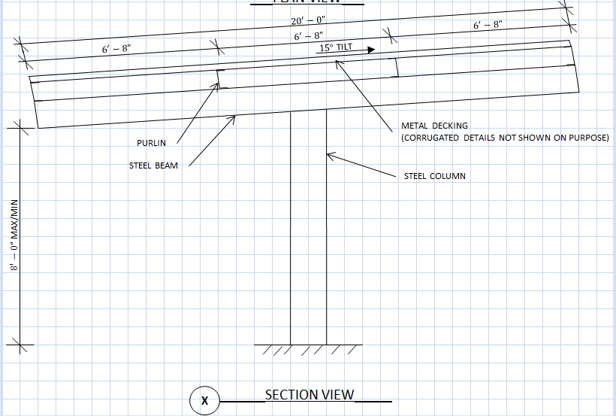
Problem Statement
Finite Element (FE) Model of a steel carport in San Diego, California.
Carport to withstand environmental loading conditions, including self-weight and live load.

Slide 2
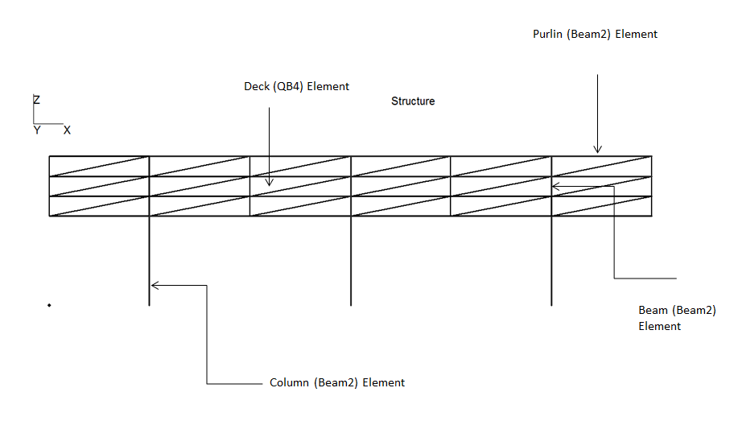
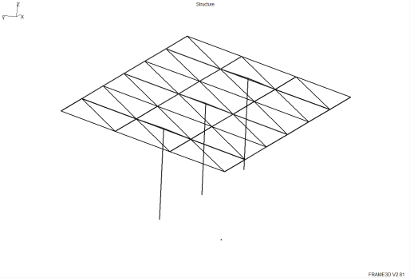
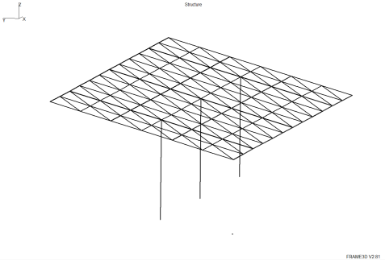
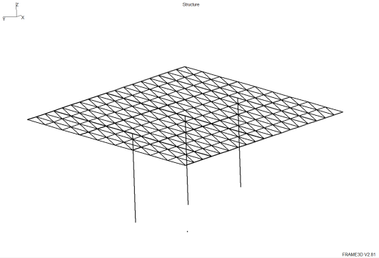
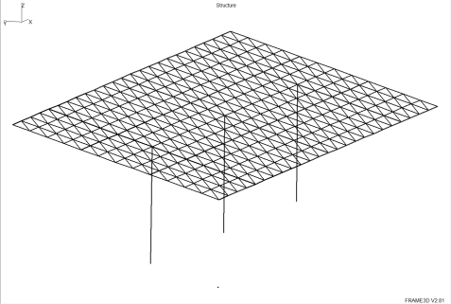
FE Model
Analysis of the decking, purlins, beams and columns (applied loads per ASCE 7-10)
Decking modeled using QB4 plate elements (4-Gauss points)
Purlins, beams and columns modeled using beam elements
Element Type | Cross-Section | Web Height (in) | Web Width (in) | Flange Width (in) | Flange Thickness (in) | Thickness (in)
Column | I-section | 8.0 | 0.5 | 5.0 | 0.5 | -
Beam | I-section | 8.0 | 0.5 | 5.0 | 0.5 | -
Purlin | Channel-section | 8.0 | 0.25 | 3.0 | 0.25 | -
Deck | Plate | - | - | - | - | 1
Material | Young’s Modulus (psi) | Density (lbm/in³) | Yield Stress (psi) | Poisson’s Ratio | Tensile Stress (psi)
A992 HRS (Beams and Columns) | 29*10⁶ | 7.3499*10⁻⁴ | 50*10³ | 0.3 | 65*10³
A446 CFS (Purlins) | 29*10⁶ | 7.3499*10⁻⁴ | 55*10³ | 0.3 | 75*10³
A446 CFS (Decking) | 29*10⁶ | 7.3499*10⁻⁴ | 80*10³ | 0.3 | 95*10³
9’-0” x 6’-8” mesh
4’-1/2” x 3’-4” mesh
3’ x 2’-3” mesh
2’-3” x 1’-8” mesh

Slide 3
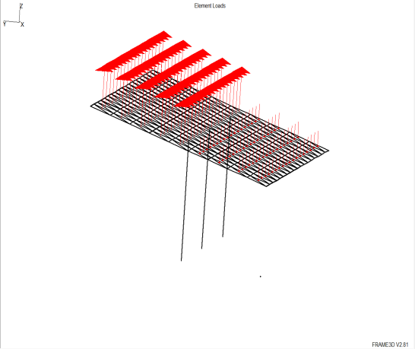
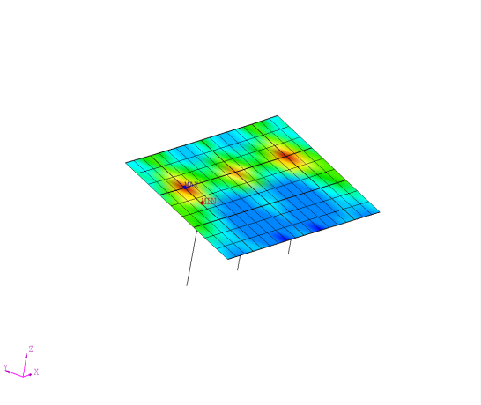
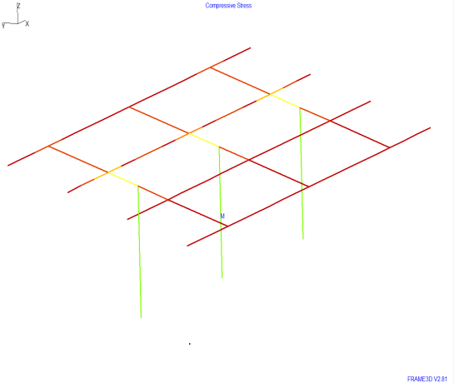
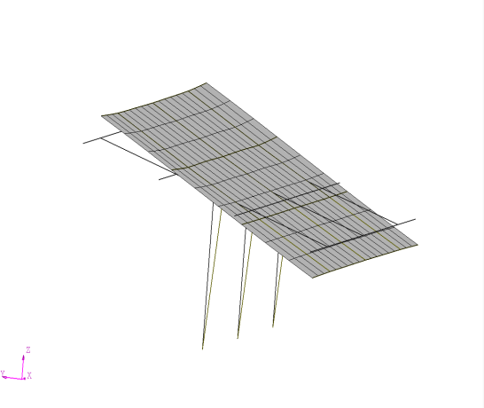
FE Results
Model | Element Type | Number of Plate Elements | Maximum Displacement (in) | Von Mises Stress (psi)
1 | QB4 | 18 | -1.11904 | 1878.53
2 | QB4 | 72 | -0.910415 | 2306.73
3 | QB4 | 162 | -0.863044 | 2635.52
4 | QB4 | 288 | -0.850099 | 2867.67
Sample Wind Loading
von Mises Stress (plate)
Compressive Stress (beam)
Deflection (plate and beam)

Slide 4
Conclusions
Higher refinement of the mesh produces convergence to the actual solution of a finite element model.
Displacements converge faster than stresses.
While the stresses converged from below (they are underestimated), the displacements converged from above (overestimated). Theoretically, the displacements should also converge from below.
Can use stresses and displacements to design structural elements per code.

